Slide 1

EQUITY RESEARCH
A custom-built software for streamlined data updates

Slide 2
WELCOME!
ABOUT US:
David Koch
(Software Engineer Student)
Lautaro Martino
(Software Engineer Student)

Slide 3
Requirements:
1. Data Source Identification: Identifying reliable sources: https://www.macrotrends.net/stocks/charts/WDAY/workday/operating-margin 2. Data Collection and Compilation: Gathering historical data for each of the listed financial metrics I only need historical data going back to 4-8 quarters, once the code/excel, it gets updated with the latest quarter data, companies release data every 3 months. once I hit a button in Excel I want to to get updated with the latest data 3. Data Structuring: Organizing the data in a user-friendly format within the Excel workbook maybe add a plot also for some metrics 5. Review and Adjustments: Making any final adjustments I would like to have the ability to add any additional stock to the excel sheet later on myself. say you prepare now for 10 stocks in 10 tabs in the same excel sheet later I add one more tab in the same sheet (copy existing one) and change stock symbol and it should gather data for that in the new tab (old tabs stay unchanged) add manual notes keep them preserved

Slide 4
Key Financial Metrics
Each company’s data will include the following key metrics: - Revenue - Net Income - PE Ratio - Assets and Liabilities - Market Cap Shares Outstanding - Debt-to-Equity Ratio | Expenses Net Margin PE ratio Book Value (Share equity) Current ratio Num shares, Dividend cash+marketable securities > short term +Long term debt, debt to equity < 0.8 No preferred stock (only common stock), retained earnings growth positive, IRR

Slide 5
We have some questions…

Slide 6
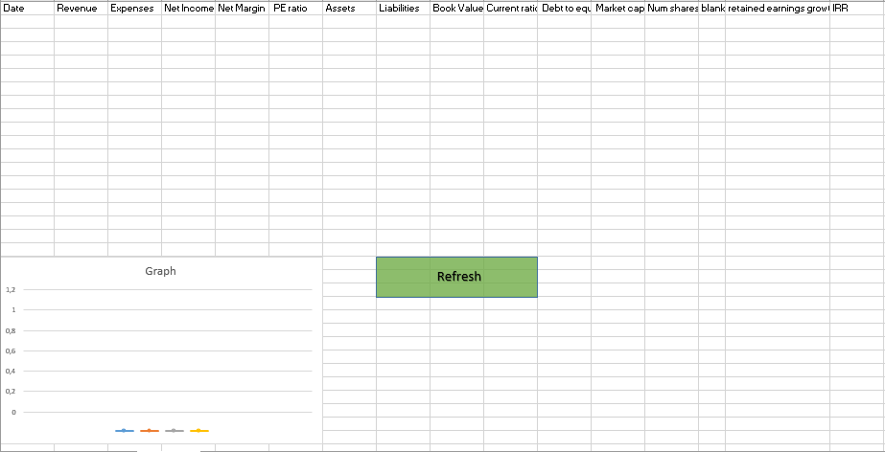
Design prototype

Slide 7
Project Timeline
The estimated time to complete this project is between 20 and 25 hours, depending on: any further customizations, the complexity of the web scraping and the revisions.

Slide 8
Thank You!
Thank you, Duminda for your time and considering us!

